Slide 1

North South University
Department of History and Philosophy
Fall, 2019
PHI 104
Section- 13

Slide 2

“We should Know Where to Stop”
Cyber space and Bangladesh Perspective
Submitted by:
Md Sharif Hossain - 1712336642

Slide 3

Cyber space and Social Media

Slide 4
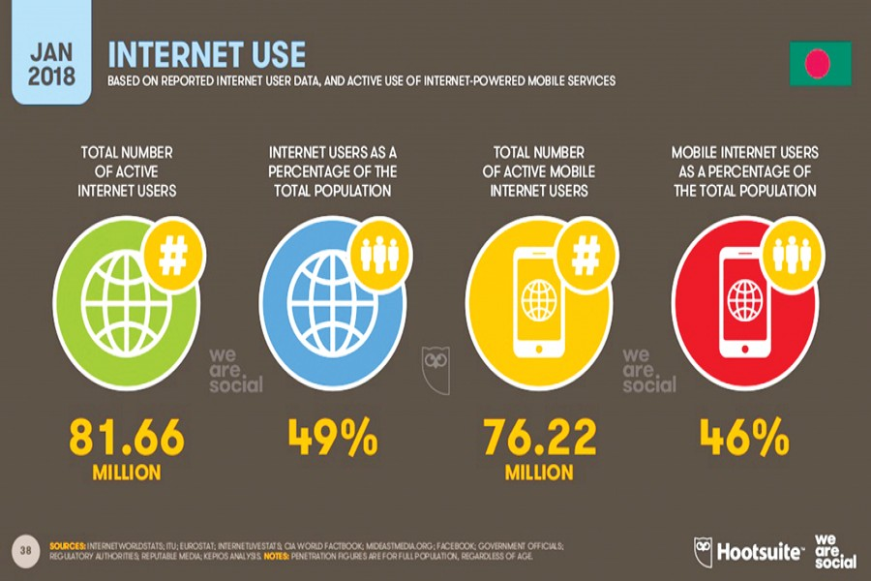
Social Media users in Bangladesh

Slide 5
Matters to think….
Are they conscious?
Are all of them respectful to others?
Do all of them abide by the Laws and Ethics?
Do all of them know what to do and what not to?

Slide 6
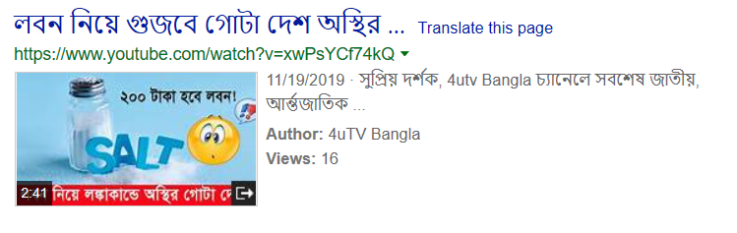
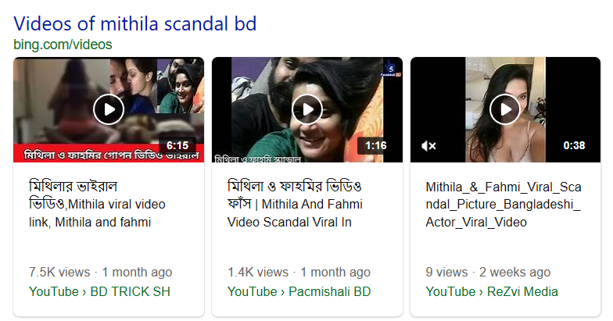
The answer is: NO

Slide 7
Is this a ‘Right’ action?
Lets find the answer at the point of view of Utilitarianism and Cyber Ethics

Slide 8
What is Utilitarianism?
Utilitarianism is generally held to be the view that the morally right action is the action that produces the most good.
According to Bentham, the GOOD= happiness= pleasure (or no pain)
It is right action if it brings about the greatest happiness for the greatest number.

Slide 9
What is Utilitarianism?
Again, Mill was convinced that some types of pleasure are more valuable than others in virtue of their inherent qualities.
He declares that the more valuable pleasures are those which employ “higher faculties”.
A competent judge who has the experience of both pleasures.

Slide 10
What is Cyber Ethics?
Cyber Ethics is the philosophic study of ethics pertaining to computers, encompassing user behavior and what computers are programmed to do, and how this affects individuals and society.

Slide 11
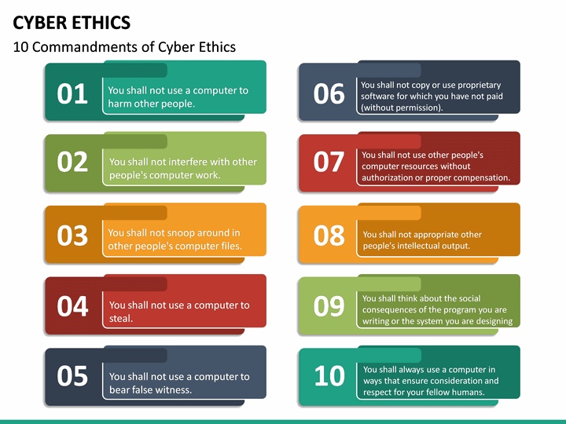
According to Cyber Ethics…

Slide 12
The problem is that…
Most of the people don’t think twice before clicking on the ‘Share’ button of any post or link. Many often rumors and personal scandals get viral for this crackpot characteristic of people. They continue posting and sharing things as they like.

Slide 13
My position is:
Both of them are WRONG actions and should be avoided. People must not spread rumor and must not share any other’s personal moments.

Slide 14
Possible arguments against my position
It’s their personal matter to share anything.
They can do anything in cyber space as they are independent to do so.
Now strong law against this action, So it can’t be wrong action.

Slide 15
Refutation of arguments against my argument
First of all, spreading rumor and sharing other’s scandal remain personal matter till there is no audience. But in social media, it gets a lot of audiences as it is an open platform. And sharing own scandal could be defined as personal matter, not other’s.
Secondly, ‘Ethics’ and ‘Law’ aren’t same things. Law goes as its own; so do ethics. Something unethical doesn’t need to be illegal always. Sometimes legal things might be unethical also.

Slide 16
Right
Wrong
Rational Judgement

Slide 17
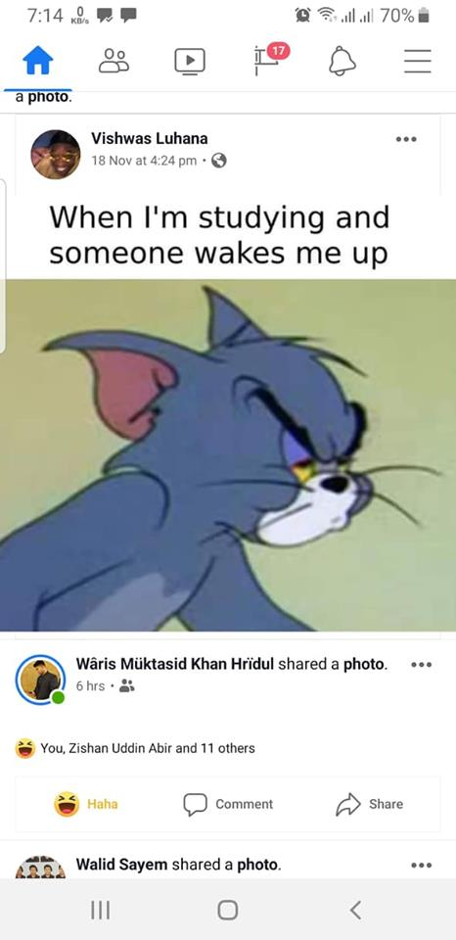
Any Questions?

Slide 18
Thank You, everyone!

